Slide 1
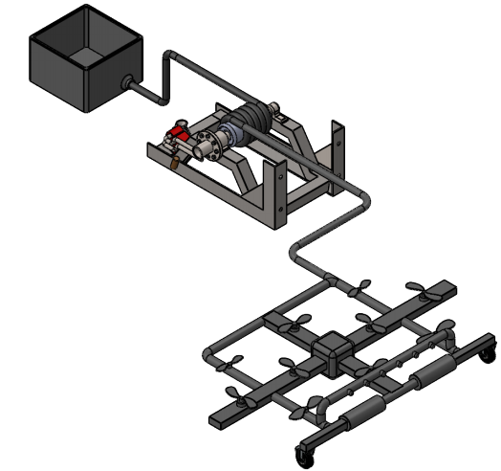
Traffic Sign Cleaning
Abdalla
Saad
Abdulrahman
Mohammed
Mosaad
Abdullah

Slide 2
Overview
Project Description
Design Description
System Functioning
Component Details
Engineering Requirements and Actions
Manufacturing and Assembly
Implementation Plan
Testing
References
Appendix

Slide 3
Project Description
Traffic Signs play an important role in controlling the traffic
Traffic Signs always uses sharp color, see from the long distance
Traffic Sign Board on the highways need to clean
Drivers need to see the instructions clearly
Traffic flow on highways cannot disrupt
Design a system that can clean traffic sign boards
  Without Disturbing the traffic flow
Client
  Dr. Hesam Moghaddam

Slide 4
Design Description
The design decided to use drone
10 propellers are using on the drone to fly in the air
Pipe Structure is using to build the drone
Nozzle are using on the design to shower water on sign boards
Soft brush rollers are using to wipe the boards
Water is supplying to the drone from ground tank
Hose is connecting with the drone to provide fail-safe

Slide 5

Design Description
Final Design CAD Model

Slide 6
System Functioning
The power supply will connect with the drone
All the propellers will start rotating
Drone will fly in the air and reach to the sign board
Hose will fly with the drone in the air
Hose is connecting with the reel from the ground
Water tank present on the ground will supply the water to the drone through the water pump and the hose

Slide 7
System Functioning
Arduino will control the drone, nozzles, and brush rollers
Drone will sprinkle the water on the sign board using the nozzles
Brush rollers will rotate and clean the water on the sign board
Brushes will absorb the water on the sign board

Slide 8
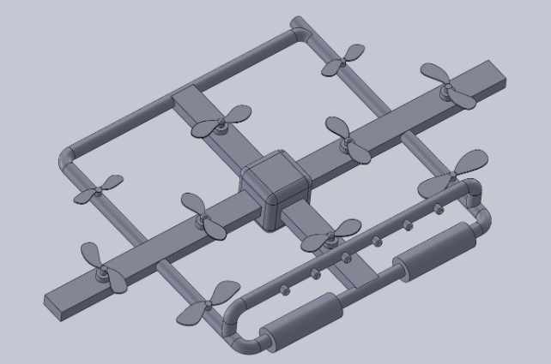
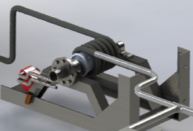
Components Details
The Drone structure
  3-4-3 map of propellers
The Reel
  Hi-speed motor

Slide 9
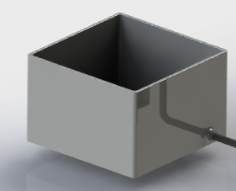
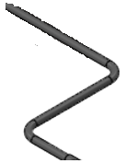
Components Details
Water Tank
  20 liter of water
Hose
  65 Feet flexible pipe

Slide 10
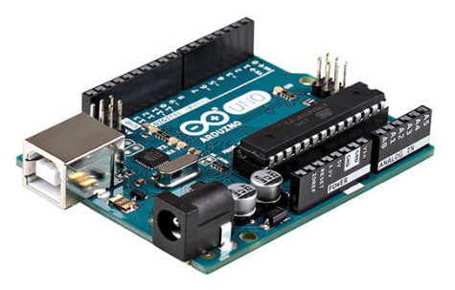
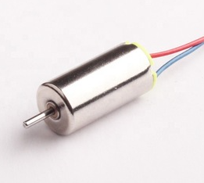
Components Details
Arduino UNO R3
6 mm DC motor
  Propellers

Slide 11
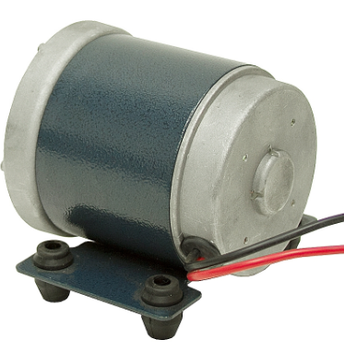
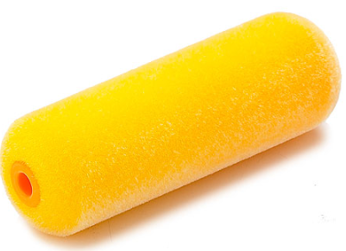
Components Details
Reel Engine
  Brushless DC Motor ¼ Hp
Brush Rollers
  Soft Fabric

Slide 12
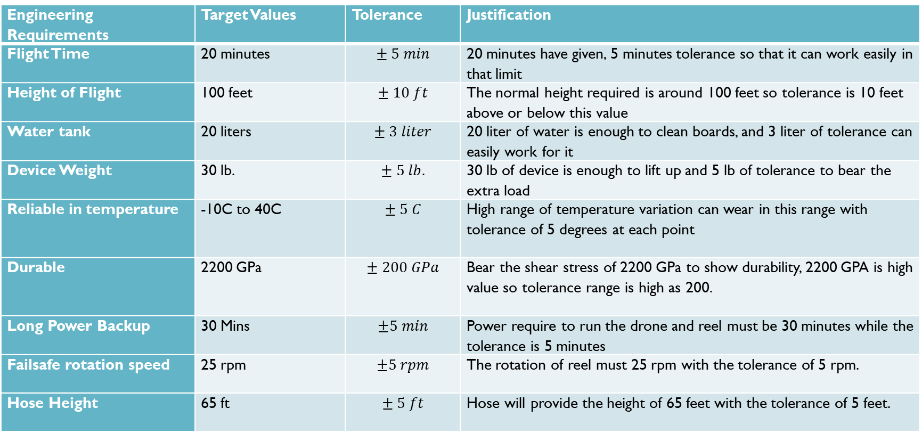
Engineering Requirements
Engineering Requirements | Target Values | Tolerance | Justification
Flight Time | 20 minutes | $$± 5 min$$ | 20 minutes have given, 5 minutes tolerance so that it can work easily in that limit
Height of Flight | 100 feet | $$± 10 ft$$ | The normal height required is around 100 feet so tolerance is 10 feet above or below this value
Water tank | 20 liters | $$± 3 liter$$ | 20 liter of water is enough to clean boards, and 3 liter of tolerance can easily work for it
Device Weight | 30 lb. | $$± 5 lb.$$ | 30 lb of device is enough to lift up and 5 lb of tolerance to bear the extra load
Reliable in temperature | -10C to 40C | $$± 5 C$$ | High range of temperature variation can wear in this range with tolerance of 5 degrees at each point
Durable | 2200 GPa | $$± 200 GPa$$ | Bear the shear stress of 2200 GPa to show durability, 2200 GPA is high value so tolerance range is high as 200.
Long Power Backup | 30 Mins | $$±5 min$$ | Power require to run the drone and reel must be 30 minutes while the tolerance is 5 minutes
Failsafe rotation speed | 25 rpm | $$±5 rpm$$ | The rotation of reel must 25 rpm with the tolerance of 5 rpm.
Hose Height | 65 ft | $$± 5 ft$$ | Hose will provide the height of 65 feet with the tolerance of 5 feet.

Slide 13
Engineering Requirements Met
Flight Time – 20 minutes
  The drone can easily fly for 20 minutes or more using the input power because the propellers using in the drone are high torque and high speed motors
Height of Flight – 100 feet
  Even though we need the maximum height of 70 feet but this drone can easily reach to 100 feet because of 10 propellers with high thrust can easily raise the device to 100 feet
  Thrust of 360 N, can generate from propellers
  Drone lifting Capacity = 82 lb.
  Total weight of System = 55 lb.

Slide 14
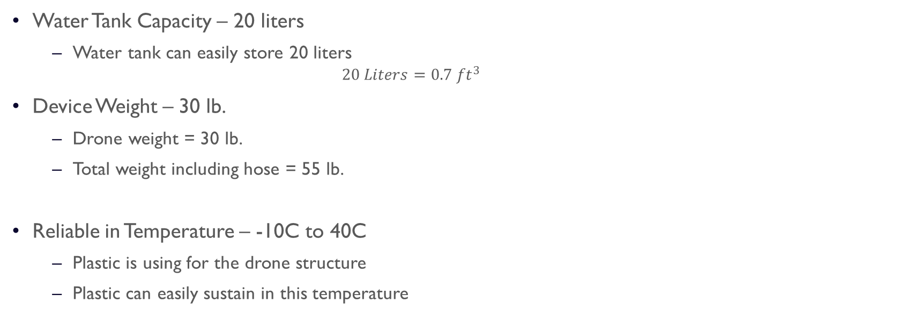
Engineering Requirements Met
Water Tank Capacity – 20 liters
  Water tank can easily store 20 liters
    $$20 Liters=0.7 ft^{3}$$
Device Weight – 30 lb.
  Drone weight = 30 lb.
  Total weight including hose = 55 lb.
Reliable in Temperature – -10C to 40C
  Plastic is using for the drone structure
  Plastic can easily sustain in this temperature

Slide 15
Engineering Requirements Met
Durable – 2200 GPa
  The device is building with ABS plastic pipe which has yield strength of more than 2200 GPa
Long Power Backup – 30 mints
  The design is taking the power from the external source rather than from the battery so this engineering requirement is not fulfilling accordingly but the power source will provide consistent power for more than 30 minutes.
Failsafe Rotation Speed – 25 rpm
  The motor connected with the reel will rotate more than 25 rpm as it is ¼ hp 12 V dc motor with the RPM of 2600

Slide 16
Engineering Requirements Met
Hose Height – 65 feet
  The hose is flexible pipe, and 65 feet long
  Total weight of hose including water = 25 lb.
  The hose can fly with the drone having 65 feet of height
Almost, all the engineering requirements have met, excluding the power backup of 30 minutes but still the system is getting power backup of 30 minutes just the change made in the design is not using of battery

Slide 17
Breakdown Task Schedule
Name | Tasks
Abdalla and Saad | CAD Model
Abdulrahman and Abdullah | Components Selection
Mohamed | Writing
Mosaad | Calculations
Abdullah Altamimi | Reviewing the work
Abdulrahman Ahmad, Abdalla and Saad | Website
Abdulrahman Ahmad, Abdalla and Saad | Presentation

Slide 18
Manufacturing
The structure need to build
  Take the full length of pipe
  Cut the pipe into the pieces
  Join the pipe pieces using elbows
  Drill the nozzles into the pipe
Take the ABS plastic sheet
  Cut the sheet and make the center box
  Cut the sheet to make the motor holders

Slide 19
Manufacturing
Components need to buy
  Propellers
  Arduino
  Reel
  Hose Pipe
  Electric Power Wire
  Motors
  Screws
  Remote Control
  Water Tank
The system can manufacture easily by purchasing above components

Slide 20
Assembly
The propellers connects with the pipe structure
Motors will place under the propellers
Fix the Arduino in the central console
Connect the Arduino with the motors
Fix the brush rollers with the Arduino

Slide 21
Assembly
Interconnect the nozzles with the Arduino
Connect the hose with the Drone
Place the reel with the hose and water tank
Connect the reel shaft with the motor
Make the connection of hose with the water tank

Slide 22
Implementation Plan
Order all the components from online stores
Make the drone structure
After the arrival of components
  Check the components individually
  Test them with different inputs
Assemble the components with the drone structure

Slide 23
Implementation Plan
Make the device operational
Test the device
Make changes in the device after testing
Final Testing

Slide 24
Implementation Plans Tasks
In-charge of Implementation
  Abdalla
Name | Tasks
Abdalla and Saad | Drone Structure
Abdulrahman and Abdullah | Testing Individual Components
Mohamed | Ordering Online Components
Mosaad | Arrange Components
Abdullah Altamimi | Writing Work
Abdulrahman Ahmad, Abdalla and Saad | Assemble all the parts
Full Team | Testing

Slide 25
Testing Plans
Flight Time – 20 minutes
  Need the timer to test this ER and see if it has fulfilled
  Timer is available in the mobile
Height of Flight – 100 feet
  Barometer and GPS device will use to determine the height of drone
  Barometer is available in the mechanical lab, GPS is present in the Arduino
Water Tank Capacity – 20 liters
  Use the water bottle of 20 liters and fill the tank to see if water tank can store 20 liters or not

Slide 26
Testing Procedure
Device Weight – 30 lb.
  Weight machine need to measure the weight of device
  Drone will place over the machine to test
  Weight machine is available in the mechanical lab
Reliable in Temperature – -10C to 40C
  Put the device in the controlled temperature room
  Test it in both highest temperature and lowest temperatures
  Available in the chemistry lab

Slide 27
Testing Procedure
Durable – 2200 GPa
  Put the structure under stress by applying the external force
  The equipment need to do is stress applying machine and test the structure
  The equipment is available in the mechanical lab
Long Power Backup – 30 mints
  To test it, timer watch need to see if it consistently get the power for 30 minutes
  Timer is available in the mobile

Slide 28
Testing Procedure
Failsafe Rotation Speed – 25 rpm
  The RPM of motor can test by through tachometer.
  Tachometer can available in the mechanical lab
Hose Height – 65 feet
  Hose height can test through the meter scale
  Meter scale can easily available in the civil lab

Slide 29
References
[1] B. Marian, “Investigation of hydraulic fitting losses”, available [online], https://www.researchgate.net/publication/325338468_Investigation_of_hydraulic_fitting_losses
[2] M. Santosh, “Compartive study for Wiper Control System Using MATLAB”, available [online], https://www.researchgate.net/publication/335524435_Comparative_Study_for_Wiper_Control_Systems_using_MATLAB_Tools
[3] P. Imade, “Design, Production, and Testing”, available [online], https://www.researchgate.net/publication/320244094_Design_Production_and_Testing_of_a_Single_Stage_Centrifugal_Pump
[4] B. Mohammed”, Power Supply Architectures for Drones”, available [online], https://www.researchgate.net/publication/336669179_Power_Supply_Architectures_for_Drones_-_A_Review
[5] L. Leo, “Working Principle of Arduino and its tools”, available [online], https://www.researchgate.net/publication/326316390_WORKING_PRINCIPLE_OF_ARDUINO_AND_USING_IT_AS_A_TOOL_FOR_STUDY_AND_RESEARCH

Slide 30


Slide 31
Appendix – Bill of Materials
Part # | Part Name | Qty | Description | Functions | Material | Dimensions | Cost
1 | 6 mm Motor | 10 | Rotate the Propellers | Rotate the propellers | Steel | 1.2 x 1 in | $82.74
2 | Steel Sheet | 1 | For Water Tank | Make the Water Tank | Steel | 100 x 100 mm | $38.32
3 | Arduino | 1 | Control the Drone | Pass the signals to each part | Silicon | 4 in x 4 in | $3.49
4 | Controller | 1 | Control the Remotely | Connect with Arduino to pass signals | Plastic | 6 x 4 in | $27.99
5 | Reel Motor | 1 | Rotate the reel | Provide Failsafe operation | Iron Copper | 15 in x 8 in | $26.28
6 | Hose | 1 | Connect with Drone and Reel | Provide Failsafe operation | plastic | 4 x 2 in | $10.50
7 | Screws | 50 | Make the connections | Hold the parts | Steel | 0.5 x 0.1 in | $1.14
8 | Pipe | 8 | Make drone structure | Design the Structure | ABS Plastic | 50 feet | $32.50
9 | Electric Power Wire | 1 | Provide Power | Connect the power with the Arduino | Copper | 10 feet | $11.96
10 | Jumper Wires | 4 | Connect between the parts | Make all the connection for supply | Copper | 6 x 0.1 in | $4.00
11 | Wheels | 2 | To move the device | Assist in moving by reducing friction | Rubber | 6 in | $2.45
12 | Propeller | 10 | Rotate the Propellers | Lift the drone with the propeller | Plastic | 4 in x 2 in | $30.55
13 | Brushes | 2 | Clean the boards | Rotate and clean the water from board | Fabric | 4 in x 2 in | $12.20
14 | Nozzles | 5 | Shower the water | Throw water on the boards | Steel | 3 in | $20.10
15 | Reel | 1 | Rotate quickly | Provide Failsafe operation | Steel | 20 in x 15 in | $50.00
16 | Adhesive lOtion | 2 | Make the connections of structure | fix the pipes and elbows | Chemical | 6 in | $2.44
Total |  |  |  |  |  |  | $356.66
Total incl. tax |  |  |  |  |  |  | $417.29

